Slide 1
Docker Fundamentals

Slide 2

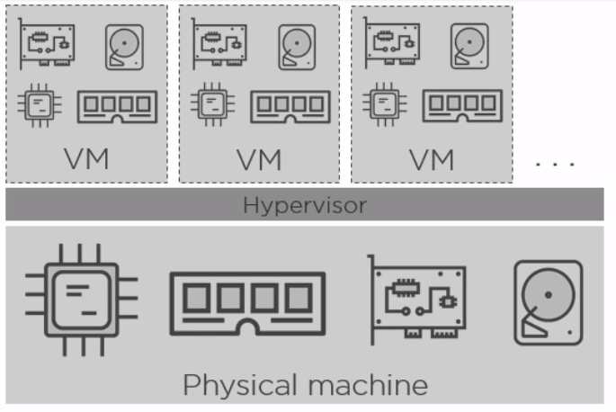
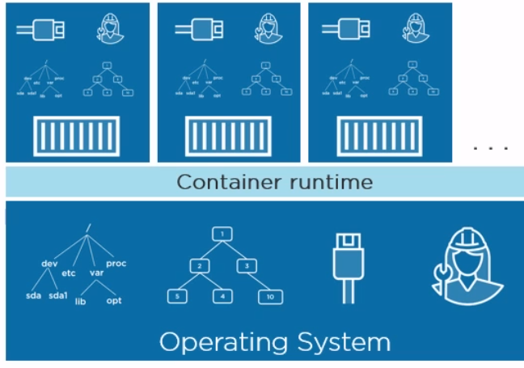
Containers vs Virtual Machine
OS
OS
OS
Notes:
We are in a world of virtualization. Virtualization attempts to make better utilization of resources. There are 2 modes of virtualization available VM and Containers.
Any virtualization works around 2 concepts: NameSpaces and Control Groups
By default these concepts are Linux Kernel primitives but there are equivalent concepts on windows platform as well.
NameSpaces are about Isolation, Control Groups are about grouping objects ex namespace and setting limits.
Name Space is a Linux concept which isolates and virtualizes system resources for a process in a such a manner that each process gets its own resources .
Such as its own IP address, host name, root file system etc.
Lets look at VM first:
VM virtualization works on top of a virtual machine manager like hypervisor. To achieve virtualization it grabs physical resources like CPU, RAM, storage, networks, then, it slices them into virtual versions, so virtual CPU, virtual RAM, virtual NICs, all that goodness, and then it builds virtual machines out of them, virtual machines that look, smell, and feel like normal physical servers. But in the end we end up running guest OS over the Host OS layer. This makes it bulkier and takes time to start as it need to boot up the Guest OS additionally to provision a VM.
Lets look into Containers:
Well not so with containers. Now, keeping this somewhat high-level here,
instead of slicing and dicing physical server resources, Docker and other container engines slice and dice operating system resources. So, they slice up the process namespace, the network stack,
the storage stack, the file system hierarchy actually. In effect, every container gets its own PID1, process ID 1, every container gets its own root file system, that's obviously / on Linux and c on Windows.
So, hypervisor virtualization virtualizes physical server resources and builds virtual machines. Container engines like Docker, they're more like operating system virtualization, they create virtual operating systems, assign one to each container, inside of which we run applications. And they're way more lightweight than VMs.

Slide 3
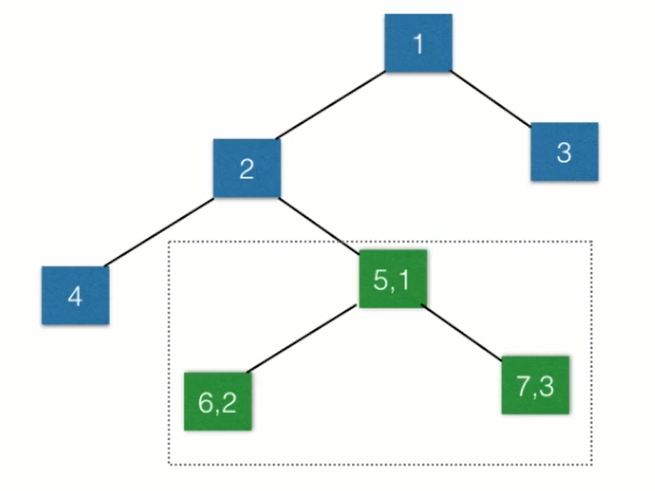
Name Space Process Isolation
Notes:
Name Space is a Linux concept which isolates and virtualizes system resources for a process in a such a manner that each process gets its own resources .
Such as its own IP address, host name, root file system etc.
Here is above example when Process 5.1 isolated it becomes the root process i.e. PID=1 for its isolated space. Any further process it starts will become its child process.

Slide 4
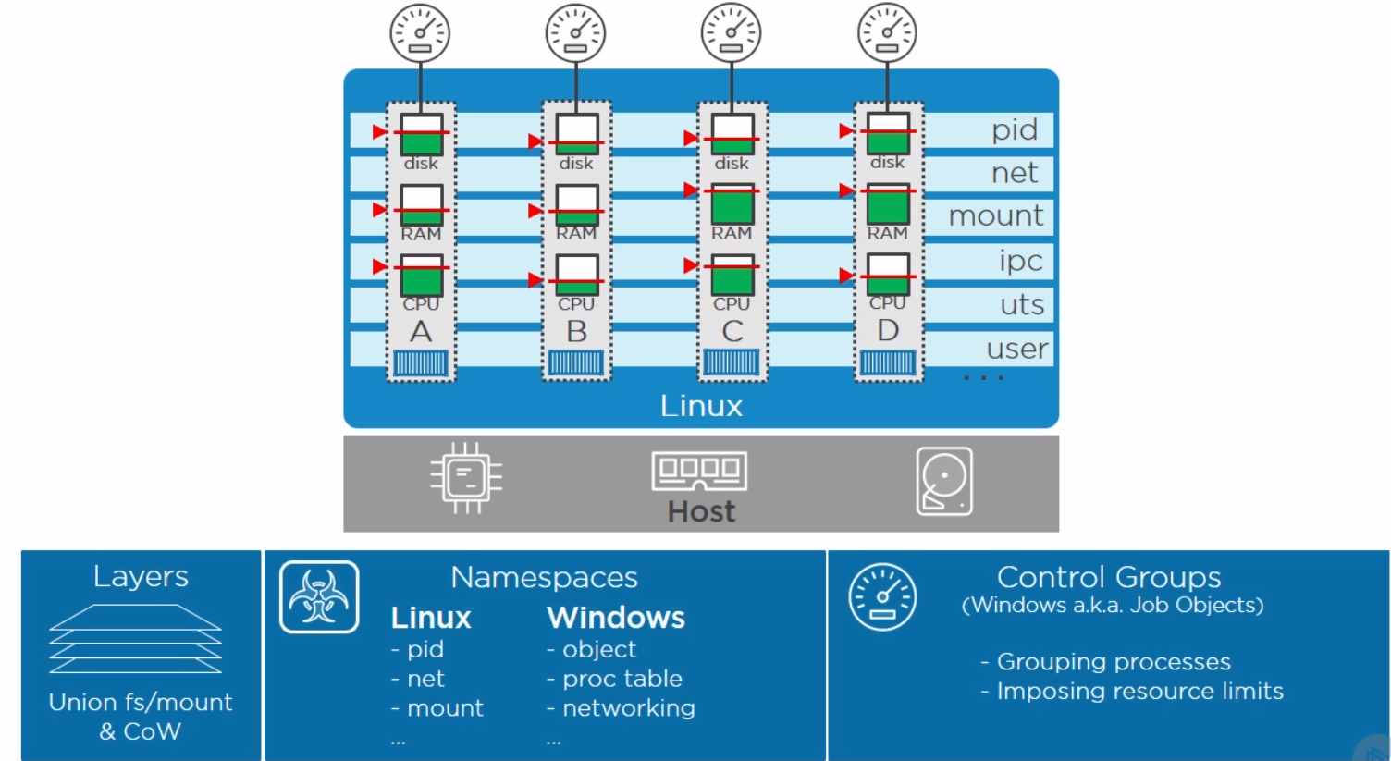
Containers on Linux
docker run -it --cpus=".5" ubuntu /bin/bash

Slide 5
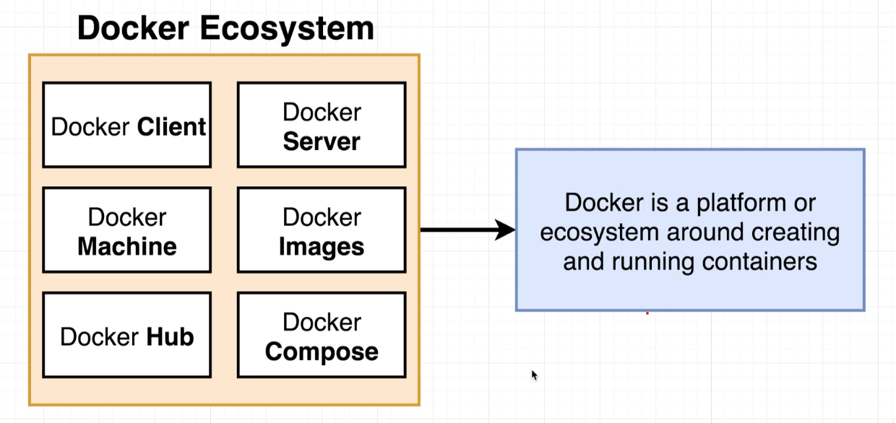
What is Docker?
Docker is a tool designed to make it easier to create, deploy, and run applications by using containers. Containers allow a developer to package up an application with all of the parts it needs, such as libraries and other dependencies, and ship it all out as one package.
Notes:
Docker is a collection of tools that provides different capabilities to build an eco-system to run containers.
Docker Machine: Docker Host running docker core engine.
Docker Client: Docker CLI client
Docker Server: Docker dameon server side process that accepts commands from Docker client.
Docker Hub: Central location that hosts the repositories containing docker images.

Slide 6
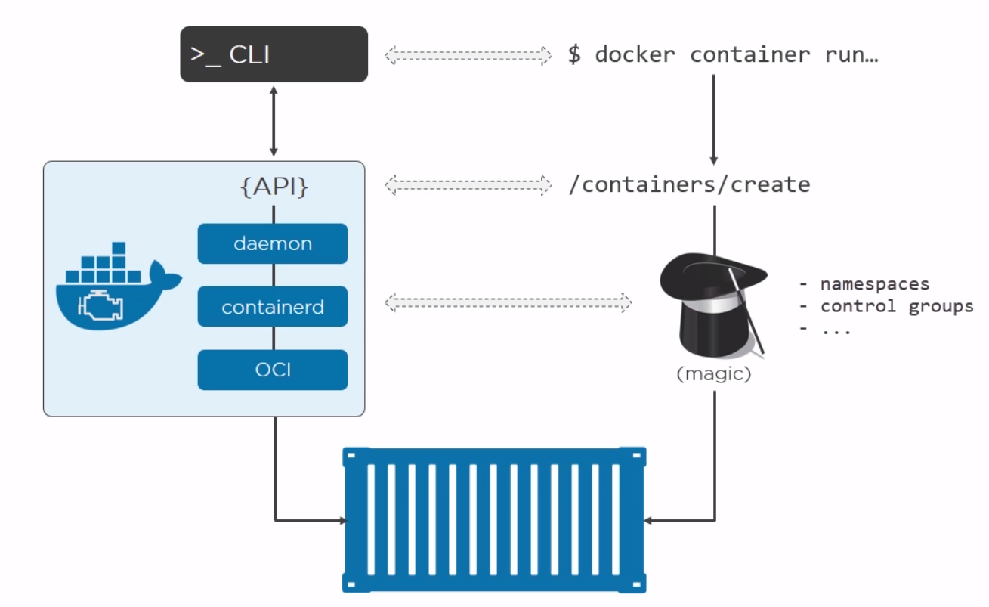
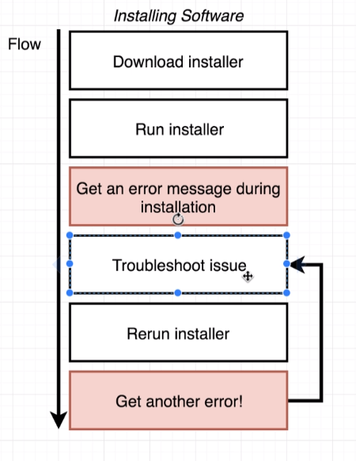
Why Docker?
Docker Containerization Unlocks the Potential for Dev and Ops.
The Docker Enterprise container platform delivers immediate value to your business by reducing the infrastructure and maintenance costs of supporting your existing application portfolio, while accelerating your time to market for new solutions.
Potential Use Case:
Consistent Deployment across environments
Lift and Shift Support across platforms.
CI/CD Pipelines
Testing
Notes:
Hides the complexity of dealing with Name Space and Control Groups for virtualization
Reduces the effort configuring the software across multiple server(s)/environments
Can be leveraged for :
Consistent Deployment across environments
Lift and Shift Support across platforms.
CI/CD Pipelines
Testing

Slide 7
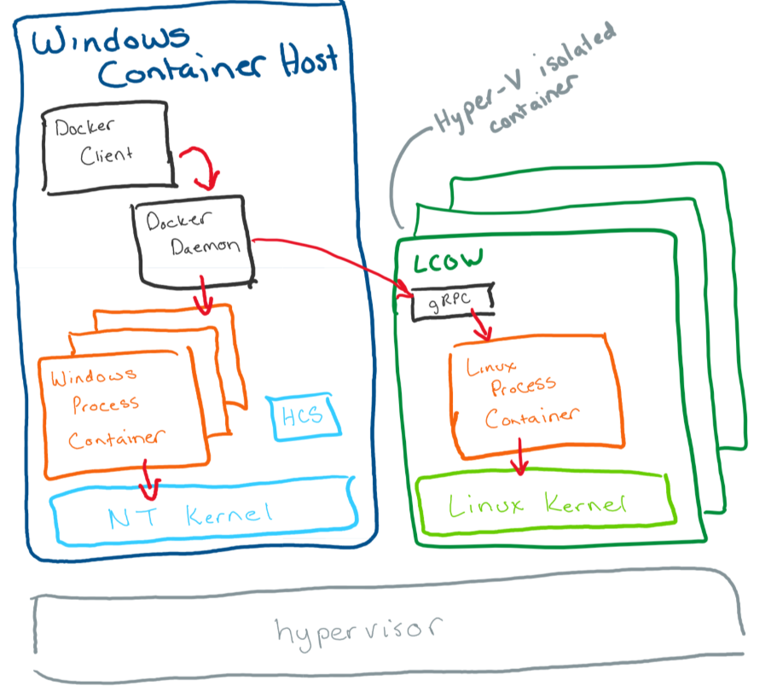
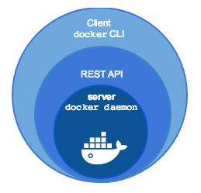
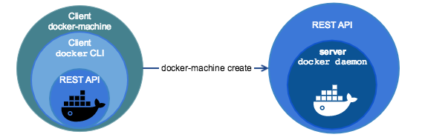
Getting Setup: No Support for A3
Install Docker Toolbox or Docker For Windows (Windows 10 pro)
Setup the Docker Machine
Start and Connect to the Docker Machine
Log into Docker Registry
Pull Image, start a container.
Glossary
Docker Machine
Boot2Docker
Docker Client
Docker Engine
Repositories
Image
Container
Notes:
Toolbox includes these Docker tools:
Docker Machine for running docker-machine commands
Docker Engine for running the docker commands
Docker Compose for running the docker-compose commands
Kitematic, the Docker GUI
A shell preconfigured for a Docker command-line environment
Oracle VirtualBox
Images - The file system and configuration of our application which are used to create containers. To find out more about a Docker image, run docker inspect alpine. In the demo above, you used the docker pull command to download the alpine image. When you executed the command docker run hello-world, it also did a docker pull behind the scenes to download the hello-world image.
Containers - Running instances of Docker images — containers run the actual applications. A container includes an application and all of its dependencies. It shares the kernel with other containers, and runs as an isolated process in user space on the host OS. You created a container using docker run which you did using the alpine image that you downloaded. A list of running containers can be seen using the docker ps command.
Docker : Docker Client + Docker Engine (Docker Dameon)
Docker daemon - The background service running on the host that manages building, running and distributing Docker containers.
Docker client - The command line tool that allows the user to interact with the Docker daemon.
Docker Store - A registry of Docker images, where you can find trusted and enterprise ready containers, plugins, and Docker editions
Boot2Docker:
Boot2Docker is a minimalist Linux distribution with the sole purpose to run Docker containers.The Boot2Docker distribution was based on Tiny Core Linux and runs completely from RAM.
The ISO installation occupied 27 MB. Boot2Docker started up in around 5 seconds. The Boot2Docker team encourages users and people in search of a way to run Docker on
Microsoft Windows and Apple MacOS to use Docker Machine. The Docker Machine tool installs Docker Engine on virtual hosts. Docker Engine deploys and runs containers from images.
What is Docker Machine:
Docker Machine is a tool that lets you install Docker Engine on virtual hosts, and manage the hosts with docker-machine commands. You can use Machine to create Docker hosts on your local
Mac or Windows box, on your company network, in your data center, or on cloud providers like Azure, AWS, or Digital Ocean.

Slide 8
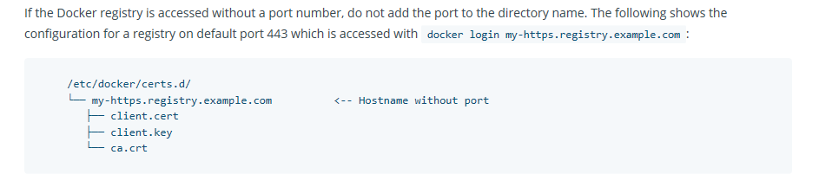
Installation and Setup Links
Outside
https://docs.docker.com/toolbox/toolbox_install_windows/
Certificates can be used for following:
Establish secure communication between docker client / docker daemon
Authenticate and access protected Repositories.
Notes:
Docker-Machine is a host for running containers. Docker machines can be created using different drivers Ex: VirtualBox, AWS, Azure etc,
Docker Machine hosts the docker daemon that exposes a rest API to listen for incoming commands.
Docker client can then be pointed to appropriate docker machine and then issue commands that will be executed via docker-machine’s docker engine.
Protect the Docker daemon socket
By default, Docker runs through a non-networked UNIX socket. It can also optionally communicate using an HTTP socket.
If you need Docker to be reachable through the network in a safe manner, you can enable TLS by specifying the tlsverify flag and pointing Docker’s tlscacert flag to a trusted CA certificate.
In the daemon mode, it only allows connections from clients authenticated by a certificate signed by that CA. In the client mode, it only connects to servers with a certificate signed by that CA.
Protect Registry with Certificates
A custom certificate is configured by creating a directory under /etc/docker/certs.d using the same name as the registry’s hostname, such as localhost. All *.crt files are added to this directory as CA roots.
The presence of one or more <filename>.key/cert pairs indicates to Docker that there are custom certificates required for access to the desired repository.
If multiple certificates exist, each is tried in alphabetical order. If there is a 4xx-level or 5xx-level authentication error, Docker continues to try with the next certificate
The Docker daemon interprets .crt files as CA certificates and .cert files as client certificates. If a CA certificate is accidentally given the extension .cert instead of the correct .crt extension, the Docker daemon logs the following error message

Slide 9
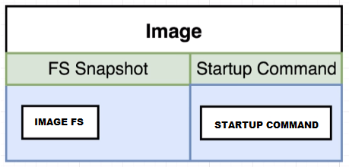
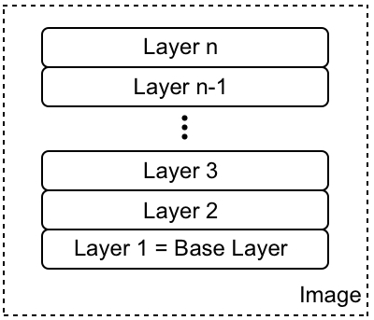
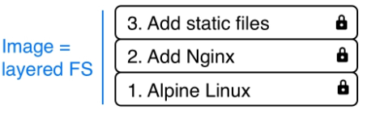
Docker Image
Docker Images are file system snapshots along with optional entry point command details. Docker images are created using Dockerfile. Dockerfile is nothing but a series of commands that incrementally build the docker image. Images can be built on top of other images. Starting image then becomes the base image.
Docker leverages Linux Union File System to lay out its images.
docker image ls
docker image inspect [image id | tag] (tag example: namespace/name:tag)
docker build –t [image-tag] . (Very imp: . Here specifies the build context. It should be relative path to artifacts or applications we are trying to package)
docker build –f [docker file path] -t [image-tag] .
Notes:
What are Images:
In Linux, everything is a file. The whole operating system is basically a filesystem with files and folders stored on the local disk. This is an important fact to remember when looking at what container images are. As we will see, an image is basically a big tarball containing a filesystem. More specifically, it contains a layered filesystem.
The first layer in the image is also called the base layer. The layers of a image are all immutable. Immutable means that once generated, the layer cannot ever be changed.
Each individual layer contains files and folders. Each layer only contains the changes to the filesystem with respect to the underlying layers. Docker uses a union filesystem to create a virtual filesystem out of the set of layers. A storage driver handles the details regarding the way these layers interact with each other.
Each layer only contains the delta of changes in regard to the previous set of layers. The content of each layer is mapped to a special folder on the host system, which is usually a subfolder of /var/lib/docker/.
Union File System.
The UnionFS forms the backbone of what is known as container images. UnionFS is mainly used on Linux and allows files and directories of distinct filesystems to be overlaid and with it form a single coherent file system. In this context, the individual filesystems are called branches. Contents of directories that have the same path within the merged branches will be seen together in a single merged directory, within the new, virtual filesystem. When merging branches, the priority between the branches is specified. In that way, when two branches contain the same file, the one with the higher priority is seen in the final FS.

Slide 10
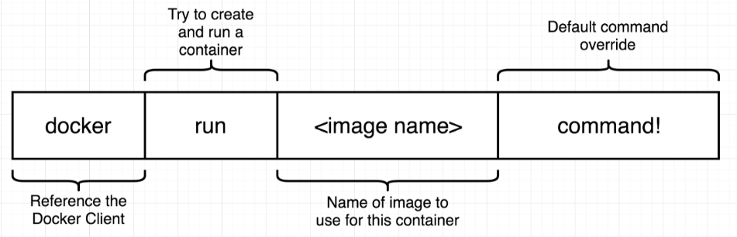
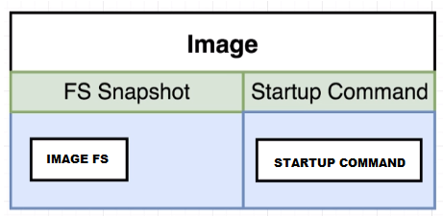
Docker Container
Docker Container is a running instance of a Docker Image
Example:
docker run --name busyboxechowelcome busybox echo Welcome Mark
docker run --name busyboxechobye busybox echo Bye Mark
docker ps –a
docker start busyboxechowelcome -a
docker start busyboxechobye -a
Other useful commands:
docker ps –a
docker create –name[container user friendly name] [image:tag]
docker stop –name[container user friendly name]
docker pause –name [container user friendly name]
docker container inspect [container id or name]
ECHO …….
BUSY BOX
IMAGE
Create Container
Name
Container Start
Port
Name : Tag
Command
Network
Env Variables
Command
Running Container
Executes Entry Command
Container Exit
Sits in Exit state
BUSY BOX
ECHO …….
Notes:
Container Life Style:
What happens when container is first created?
Creating a container and running a container are separate processes.
When we are creating the container we are just setting up the File System Snap Shot to be used to create the container.
When we start the container, the configured Entry point command is executed.
One point to remember is that once a container is created its state is well established and it will always execute through same state whenever started.
Also its important to note that container exits after it has successfully completed its entry point commands. Ex: BusyBox exited after executing the start up command.
Typical apache containers holds the tomcat in listening mode so they don’t exit once started, unless tomcat has stopped or crashed for some reasons.
Any commands that are specified with the docker run will be appended to the entry point command list.
docker run = docker create + docker start
docker start –a : this –a flag will attach the container stdin|stdout stream to the host and it will display the execution outputs.

Slide 11
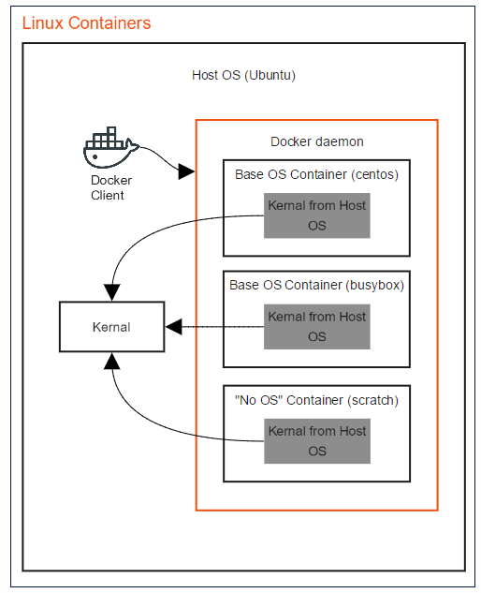
Container
Container Host: Also called the Host OS. The Host OS is the operating system on which the Docker client and Docker daemon run. In the case of Linux and non-Hyper-V containers, the Host OS shares its kernel with running Docker containers. For Hyper-V each container has its own Hyper-V kernel.
Container OS: Also called the Base OS. The base OS refers to an image that contains an operating system such as Ubuntu, CentOS, or windows servercore. Typically, you would build your own image on top of a Base OS image so that you can take utilize parts of the OS. Note that windows containers require a Base OS, while Linux containers do not.
Operating System Kernel: The Kernel manages lower level functions such as memory management, file system, network and process scheduling.
Notes:
In the above example
The Host OS is Ubuntu.
The Docker Client and the Docker Daemon (together called the Docker Engine) are running on the Host OS.
Each container shares the Host OS kernel.
CentOS and BusyBox are Linux Base OS images.
The “No OS” container demonstrates that you do not NEED a base OS to run a container in Linux. You can create a Docker file that has a base image of scratch and then runs a binary that uses the kernel directly.
Docker images are layered. When you build a new image, Docker does this for each instruction (RUN, COPY etc.) in your Dockerfile:
create a temporary container from the previous image layer (or the base FROM image for the first command;
run the Dockerfile instruction in the temporary "intermediate" container;
save the temporary container as a new image layer.
The final image layer is tagged with whatever you name the image.
Union file systems
Union file systems, or UnionFS, are file systems that operate by creating layers, making them very lightweight and fast. Docker Engine uses UnionFS to provide the building blocks for containers. Docker Engine can use multiple UnionFS variants, including AUFS, btrfs, vfs, and DeviceMapper
The operating system of the host is not the operating system running in the container. That is the beauty of using containers. For example: the OS of the host could be RedHat and the OS of the container could be Ubuntu. The only thing that the host and container share is the kernel of the host. The filesystems and everything else are of their respective operating systems. Applications running in an Ubuntu container are running on Ubuntu. Applications running in an Alpine container are running on Alpine. It doesn’t matter that the host might be CentOS or any other Linux distro. Every container is running some linux distro that does not have to be the host distro
http://www.floydhilton.com/docker/2017/03/31/Docker-ContainerHost-vs-ContainerOS-Linux-Windows.html

Slide 12
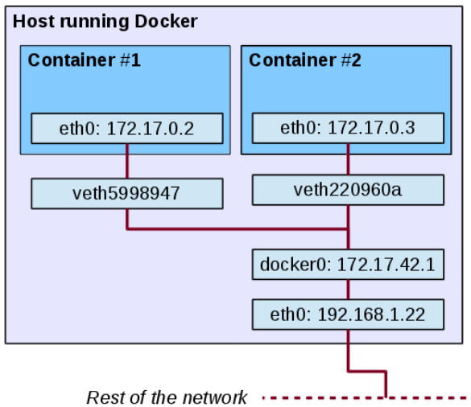
Containers on Single Host

Slide 13
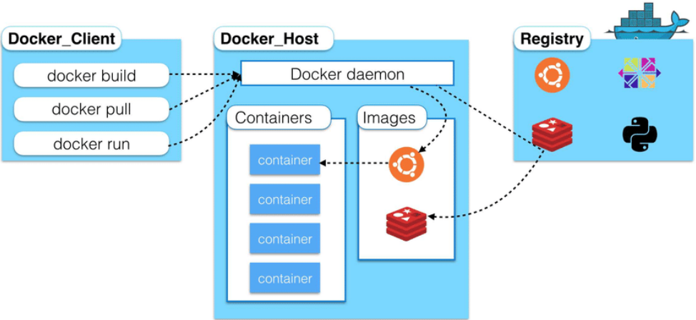
Docker Container Build Execution Cycle

Slide 14
Packaging Applications Using Docker
Examples and Deck:
https://github.com/CodeItOnGit/simple-springboot-project
https://github.com/CodeItOnGit/presentations

Slide 15
Simple Docker File: Dockerfile
# All comment lines start with # # Specify base image FROM tomcat:9-jre8-alpine # Set Author Reference LABEL [Author Name] # Copy the WAR file to the container ADD /target/ [your application.war] /usr/local/tomcat/webapps/[your application.war] # Update the WAR file timestamp. RUN sh -c 'touch /usr/local/tomcat/webapps/ [your application.war] '
# You can add any number or Run Commands in the Dockerfile
#Optionally you can specify the Entry Point command. If not specified EntryPoint command of base image is executed.
#Restart the tomcat.. ENTRYPOINT ["catalina.sh", "jpda", "run"]
Commands to build a Docker image from the Dockerfile.:
docker build –t [image-tag] . (Very imp: . Here specifies the build context. It should be relative path to artifacts or applications we are trying to package)
docker build –f [docker file path] -t [image-tag] .
Notes:
Dockerfile is the name of docker file. This is case sensitive name and has no extension.
Example shows a simple Docker file that can deploy a java web application war file in the Tomcat Container.
Docker images are layered. While building the docker image from docker file docker client sends the build context to the docker engine a.k.a Docker daemon process. So its possible that docker client can point to a remote Docker daemon process.
Dockerfile is executed from top to bottom executing each instruction. So here is what happens:
Docker engine checks Docker cache for base image. If no base image is there Docker engine downloads the base image to local cache.
Sets Current Image: base image
While there are Steps in Dockerfile:
Docker engine creates a temporary container from the Current image.
Docker engine executes the Run Command or instruction in the Dockerfile. This modifies the File System State.
Docker creates the image out of current container and stores in local cache.
Current image: latest image created in step above.
End While
Final Image is the Current Image. Docker then applies the tag to the image if specified.

Slide 16
Docker image creation process
Sets Current Image: base image
While there are Steps in Dockerfile:
Check if Current Image is not in local cache. Download Current Image from specified repository.
Docker engine creates a temporary container from the Current image.
Docker engine executes the Run Command or instruction in the Dockerfile. This modifies the File System State.
Docker creates the image out of current container and stores in local cache.
Current image: latest image created in step above.
End While
Final Image is the Current Image. Docker then applies the tag to the image if specified.
Example: Following command:
docker build –f ./dockerfilepath/Dockerfile –t simple/app:1.0 .
Will result in an image with tag simple/app:1.0
Note you cannot create the image with the same namespace/name:tag again. Unless you drop the image from local cache. docker rmi [image id | tag]
Also image cannot be deleted if any containers are currently referencing the image.
Notes:
Docker Caching:
Also note that when you run the same Dockerfile again Docker is intelligent enough to leverage the local cache and detect from where changes have been done to the Dockerfile. All steps prior to the changed steps will go through quick as Docker would know nothing has changed prior to changed step so use cached image.
Note you cannot create the image with the same namespace/name:tag again. Unless you drop the image from local cache.
Also image cannot be deleted if any containers are currently referencing the image.

Slide 17
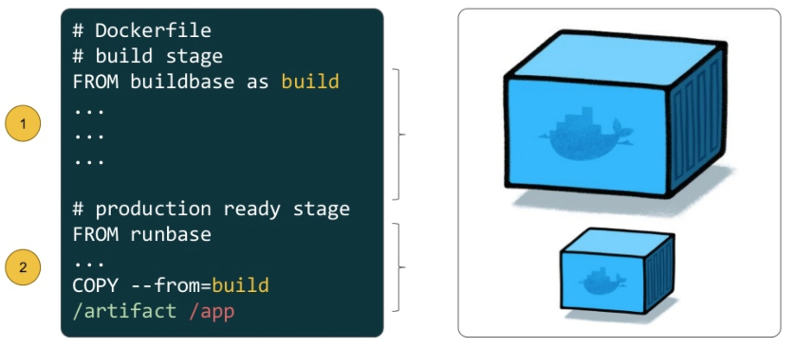
Multi Stage Docker File
Named stages in Dockerfile
Reference out puts from named stage later
Build leaner image that is production ready
Example:
Use Maven image to build the Jar/War -→ Use output war to package in Tomcat Image

Slide 18
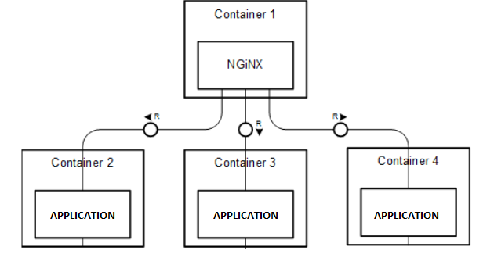
Scaling Docker Containers
Run multiple instances of your application containers.
Use load balances with schemes to redirect traffic to different containers.
You can also connect to external load balancers. Or make use of software load balancer in container.

Slide 19
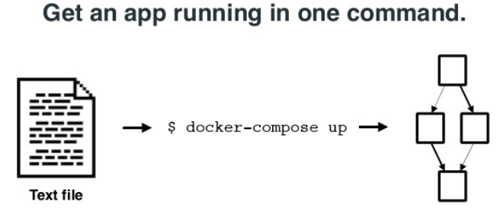
Docker Compose
docker-compose [option] command Looks for docker-compose.yml file.
Provides easy way to spin up multiple containers using a single file.
Can refer to images or other build Dockerfiles.
Support notion of named services. IP based linking not required.
Sets up a network based on the project name /file location and connect the containers on the network.
docker-compose up –d
docker-compose down
Notes:
Environment Variable Precedence:
When you set the same environment variable in multiple files, here’s the priority used by Compose to choose which value to use:
Compose file
Shell environment variables
Environment file
Dockerfile
Variable is not defined

Slide 20
Useful commands : Docker CLI
docker-machine create: Create a docker machine based on boot2docker vm.
docker-machine inspect: Displays docker machine configuration in json format.
docker ps: List all running containers.
docker images ls : List all local images.
docker pull [image|tag]: Pulls the specified image from the connected docker repository.
docker push [image|tag]: Pushes the specified image from the connected docker repository.
docker build: Builds the docker image using Dockerfile
docker create [OPTIONS] IMAGE [COMMAND] [ARG...]: The docker create command creates a writeable container layer over the specified image and prepares it for running the specified command. The container ID is then printed to STDOUT. This is similar to docker run -d except the container is never started
docker run [OPTIONS] IMAGE[:TAG|@DIGEST] [COMMAND] [ARG...] : Runs a docker container from image.
docker container start [Container ID]: Starts a docker container.
docker rm $(docker ps -aq) : Deletes all containers from local host.
docker rmi $(docker images -q): Deletes all images from local cache.
docker stats [container name/ID] [container name/ID] : Show the current load on each container specified – it will show CPU%, memory usage, and network traffic.
docker logs [-f] [container name/ID]: Shows the latest output from the container. The -f option “follows” the output, much like a console “tail-f” command would.
docker inspect [container name/ID]: Dumps all of the configuration information on the container in JSON format.
docker port [container name/ID]: Shows all of the port forwarding between the container host and the container.
docker exec [-i] [-t] [container name/ID]: Executes a command on the target container (-i indicates to run interactively, -t is pseudo-tty). This command is very commonly used to get a container shell:

Slide 21
Practice Links
https://docs.docker.com/machine/get-started/
https://github.com/docker/labs/tree/master/beginner/
https://medium.com/@betz.mark/ten-tips-for-debugging-docker-containers-cde4da841a1d
https://github.com/docker/labs/blob/master/developer-tools/java/chapters/ch02-basic-concepts.adoc
https://fly.io/articles/load-balancing-a-fleet-of-docker-containers-using-fly/

Slide 22
Assignment
Complete open JDK docker file to run application as stand alone container.
Use Open JDK instead of Tomcat to execute the war/jar file.
Hint:
FROM openjdk:8-jdk-alpine

Slide 23



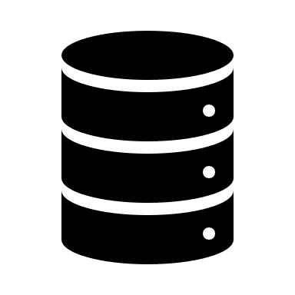
ORACLE DB Containers
Private Nexus Docker Repository
Dockerfile
Base Oracle 12.Slim Image
Customized Image
Based on Oracle 12.1 Slim image
Fast Container/DB Spin-up
Database as Scratch Pads for Quick Testing
Re-Publish images from Container States
Database Images…
Run Db Containers From Image
Client Apps or Teams
Publish Image from Containers
HOST PORT: 1521
PORT: 1521
DB Container
HOST PORT: 1522
PORT: 1521
DB Container
HOST PORT: 1523
PORT: 1521
DB Container
Docker Host Dedicated or Developer Box

